Slide 1
Phishing Awareness Simulation
Using Social Engineering Techniques
Major Project – Cybersecurity
Prepared by: Yash and Sharyu Pravin Ghorpade
Academic internship submission
Cybersecurity Internship Major Project

Slide 2
Problem Statement
Phishing exploits human trust, urgency, fear and curiosity.
Users may click links or attempt to disclose credentials before verifying a request.
Organizations need awareness testing that is measurable and safe.
This project demonstrates the behavior without collecting real credentials.
Cybersecurity Internship Major Project

Slide 3
Objectives
Understand common phishing and social-engineering techniques.
Design a realistic but harmless simulated email.
Build a local demonstration login page using HTML/CSS/JavaScript.
Measure clicks, demonstration data-entry attempts and reports.
Analyze results and recommend preventive controls.
Cybersecurity Internship Major Project

Slide 4
Common Phishing Indicators
Unexpected account or security warning
Urgent deadline or threat of account restriction
Generic greeting or unusual sender details
Request to click a link or open an attachment
Request for passwords or sensitive information
Safer response: pause, verify through a known channel, then report
Cybersecurity Internship Major Project

Slide 5
System Architecture
Landing Page
Simulation Email
Demo Login
Results
Local-only application
Browser localStorage stores aggregate counters only
No backend and no external credential transmission
Cybersecurity Internship Major Project

Slide 6
Ethical and Safety Controls
Informed consent is required before testing.
Reserved .example sender/domain; no real organization impersonation.
No email delivery or external tracking.
No real password should ever be entered.
Form values are discarded; only the event is counted.
Results should be anonymized and reported in aggregate.
Cybersecurity Internship Major Project

Slide 7
Implementation
HTML5: landing page, email simulation and login interface
CSS3: responsive and presentation-friendly interface
JavaScript: local event counters and dashboard
Python + Pandas: result analysis
Matplotlib: demonstration results chart
Local HTTP server: safe classroom/lab execution
Cybersecurity Internship Major Project

Slide 8
Demonstration Workflow
1. Participant reads consent and starts the simulation.
2. Participant sees the simulated account-warning email.
3. Participant may report it, ignore it, or click the link.
4. If the demo login is reached, any submitted values are discarded.
5. Dashboard records aggregate behavioral counters.
6. Researcher analyzes results and provides awareness feedback.
Cybersecurity Internship Major Project

Slide 9
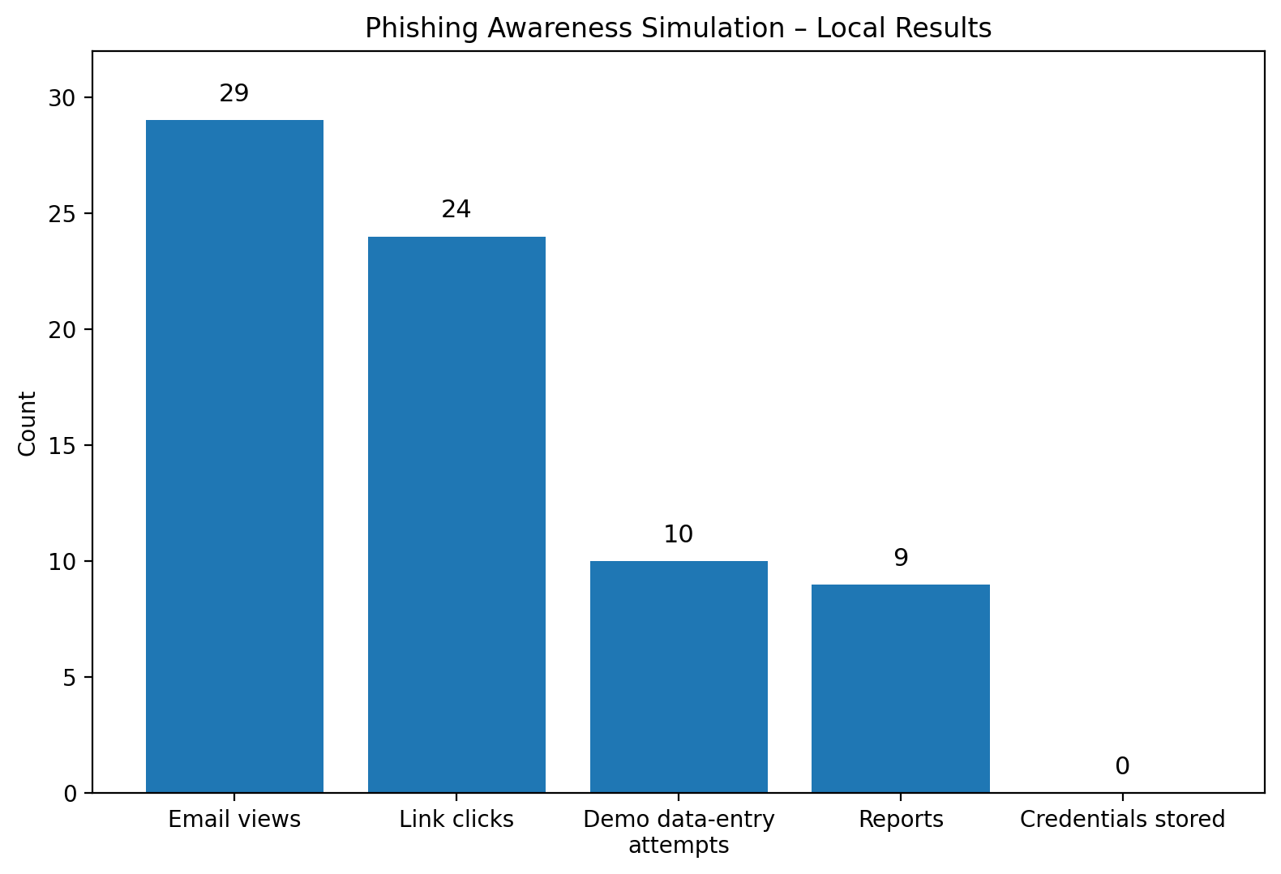
Demonstration Results (Synthetic Data)
Participants: 29
Link clicks: 24 (82.8%)
Demo data-entry attempts: 10 (34.5%)
Reports: 9 (31.0%)
These values are synthetic demonstration data, not a real participant study.
Cybersecurity Internship Major Project

Slide 10
Lessons Learned
Urgency and account warnings can increase risky interaction.
A click is not the same as credential disclosure, so multiple metrics are useful.
Reporting is a positive security behavior that should be encouraged.
Safe simulations can teach phishing cues without harvesting credentials.
Technical controls and user awareness must work together.
Cybersecurity Internship Major Project

Slide 11
Preventive Measures
User awareness: pause, inspect, verify and report.
MFA: use strong multi-factor authentication; prefer phishing-resistant methods where supported.
Email security: filtering, URL protection and attachment scanning.
Least privilege: limit access to only what each role needs.
Password hygiene: unique passwords/passphrases and password managers.
Incident response: fast reporting and credential-reset procedures.
Cybersecurity Internship Major Project

Slide 12
Conclusion & References
The project provides a safe local phishing-awareness simulation.
Behavioral metrics can identify awareness gaps and guide training.
The strongest defense combines people, process and technology.
Key references: FTC phishing guidance; NIST SP 800-63B; CISA phishing guidance.
consumer.ftc.gov • pages.nist.gov/800-63-4/ • cisa.gov
Cybersecurity Internship Major Project

